Slide 1



Introducing Majisemi: 'Seri ous' B2B Marketing Suppor t Starting with Webinars
For those considering Majisemi for the first time
Seminars strong in attracting attendees
No.1
Seminars strong in acquiring new business negotiations
No.1
Seminars chosen by IT managers
No.1
Survey by Japan Marketing Research Organization Overview: 2021 Service Comparison Impression Survey

Slide 2
Introduction
Purpose of today's meeting
For companies considering "Majisemi" for the first time, we will discuss the following topics.
Hearing about marketing challenges
How to utilize Majisemi?
©2018 MAJISEMI Inc.

Slide 3
Hearing
©2018 MAJISEMI Inc.

Slide 4
Hearing
Issue Identification
■ About the products you want to introduce in the seminar
・Which product or service?
・Who is the target audience (people you want to invite to the seminar)?
・Industry, company size, department, position, etc.
※ Majisemi specializes in "IT departments, DX departments, security departments across all industries, and production/manufacturing departments in factories"
・What are the competing products?
・What are the strengths and differentiation points compared to competing products?
©2018 MAJISEMI Inc.

Slide 5
Hearing
Issue Identification
■ On the necessity of seminars (webinars)
・What is considered important as a means of lead acquisition?
・Seminars (webinars)
・Websites (content marketing)
・リアル展示会
・比較サイト
・GoogleやFacebookなどへの広告
・テレアポ
・その他
■予算の状況
・リード獲得単価、アポ獲得単価
・セミナー（ウェビナー）の予算の有無、及び金額
・上記リード獲得手段の予算の割合
・予算の策定、決定時期
©2018 MAJISEMI Inc.

Slide 6
Hearing
Issue Identification
■セミナー（ウェビナー）の目的／課題
・より多くのリードを獲得したい／集客できない
・ターゲットに合ったリードを獲得したい／リードの質が悪い
・ウェビナーから商談につなげたい／商談につながらない
・ウェビナーの運営を代行してほしい／運営が大変
・まずはスモールスタートでウェビナーをやってみたい
・その他
・ウェビナーを活用した、東南アジアにおける新規顧客開拓やテストマーケティング
©2018 MAJISEMI Inc.

Slide 7
なぜ「ウェビナー」なのか？
©2018 MAJISEMI Inc.

Slide 8
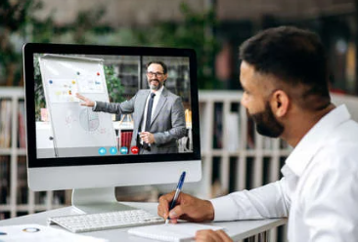

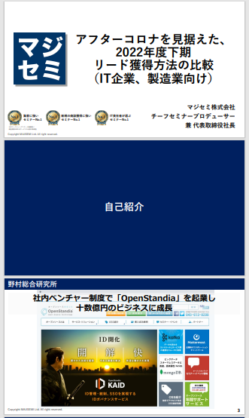
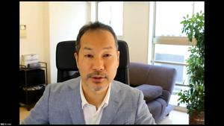
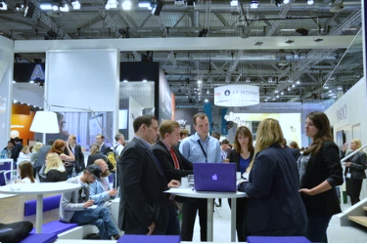
BtoBマーケティングにおけるウェビナーの役割
Webinar
as a Service
Lead acquisition
Lead Nurturing
Proposal & Order
課題に
気づいてない
課題に気づき
社内で検討
製品・サービスの
候補を捜す
製品・サービスを絞って
評価・選定、稟議
課題に気づかせる
課題について深く理解させ、
解決方法を提示する
競合よりもお客様に早く接触し、課題解決をサポートする
数社～十数者程度の検討の候補に入り、２～３社の最終候補に残る
２～３社の最終候補から自社を選んでもらう
Utilization of Webinar Content
課題に気づかせる。
課題について深く理解させる。
競合よりもお客様に先に接触し、自社を知ってもらう。
When holding a webinar,
a lot of content is generated
● Presentation materials → White Paper
● Presentation video → YouTube, Social Media
● Presentation content → SEO articles, Blog
Webinar
Field Sales
Webサイト
Content Marketing
Webinar
Social Media Advertising
Deeply understand the issues.
Also provide competitive comparison information and information about our products.
For nurturing existing leads.
リアル展示会
オンラインイベント
Document Download
Field Sales
©2018 MAJISEMI Inc.

Slide 9

Email Advertising
Positioning of Webinars in Lead Acquisition
planning
Cost per lead
Telemarketing
¥30,000
Webinar
リアル展示会
Listing/Social Media Advertising
Visitor
14,500 yen
Majisemi
Club
¥10,000～
¥10,000
Online
Exhibition
(Large-scale Webinar)
Comparison Sites
Document Download
On-Demand
Video Distribution
¥5,000
リアル展示会
Joint exhibition
Low
Interest
High
©2018 MAJISEMI Inc.

Slide 10
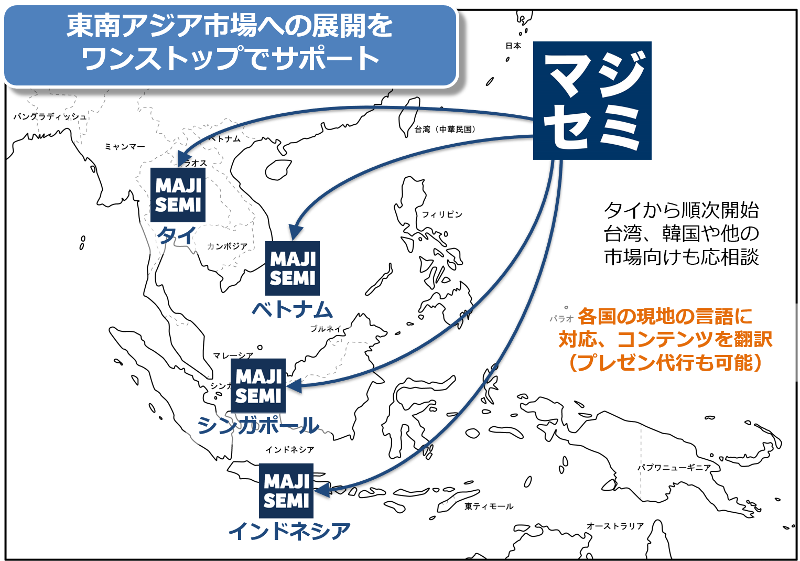
Supporting expansion into Southeast Asia using webinars
planning
Webinars can be broadcast to Southeast Asia at nearly the same cost as domestic Japan.
Your company only needs to prepare a presentation video (plus slides) in Japanese (or English).
Majisemi handles everything from adding subtitles in local languages, translating slides, to the day of the broadcast.
Options include post-webinar lead follow-up and secondary use of webinar videos with local language support.
Promoting joint exhibitions at trade shows held in Southeast Asia.
©2018 MAJISEMI Inc.

Slide 11


Why start with webinars?
planning
Cold calls or direct mail from no prior contact can lead to distrust.
First, by hosting a webinar that 'provides valuable information', you can establish the initial contact and
gain 'credibility and trust'.
Features of webinars
When emailing the entire list
Can provide an 'interactive experience'
Live Q&A sessions
Demos and factory tours while receiving questions and requests
Can obtain 'live feedback'
Pre/post surveys, as well as polls and questions during the presentation
Can attract viewers with 'high interest'
In small webinars, people troubled by issues your products/services can solve participate
Build trust by 'sharing the space'
Recognized as a 'teacher'
Building trust through communication such as Q&A
0.7%
70%
The response rate when sending materials via email
is about 100 times!
When emailing seminar participants
Face-to-face communication with customers
can enhance credibilit y and trust
The response to subsequent follow-up
is approximately 100 times different
※According to our research
©2018 MAJISEMI Inc.

Slide 12
Overview of Majisemi's services
©2018 MAJISEMI Inc.

Slide 13
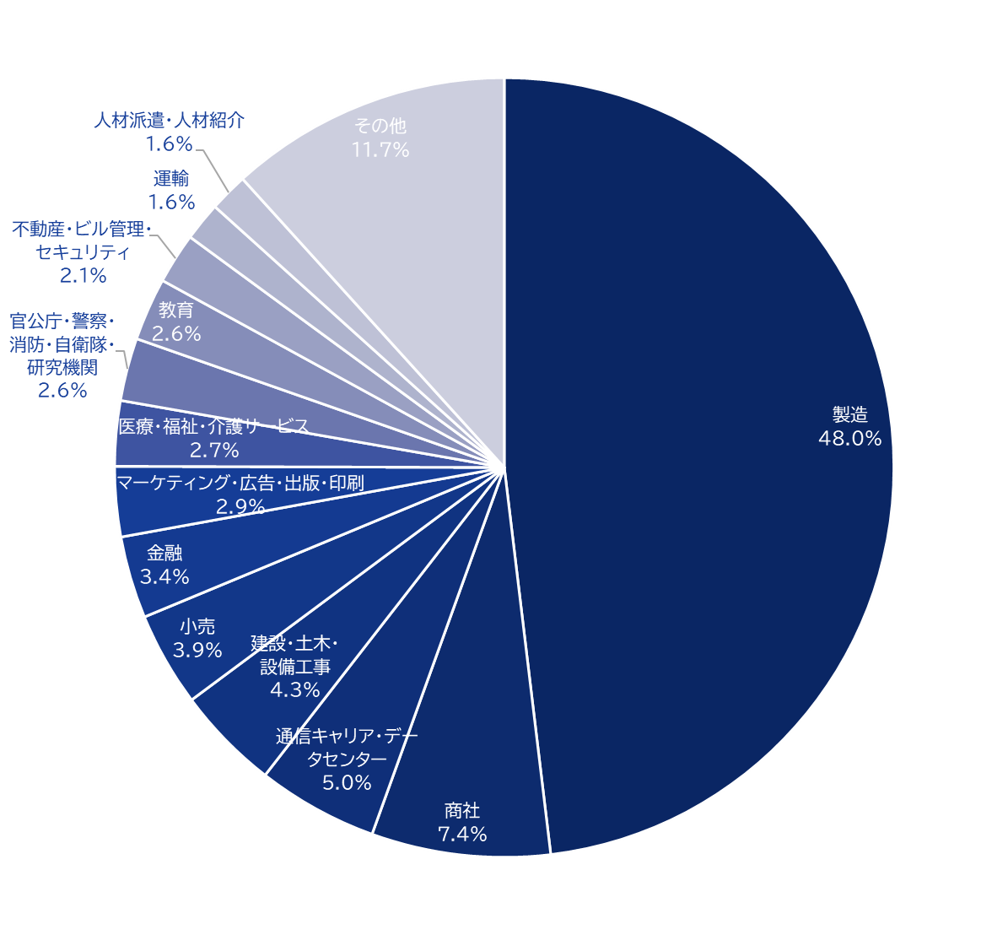
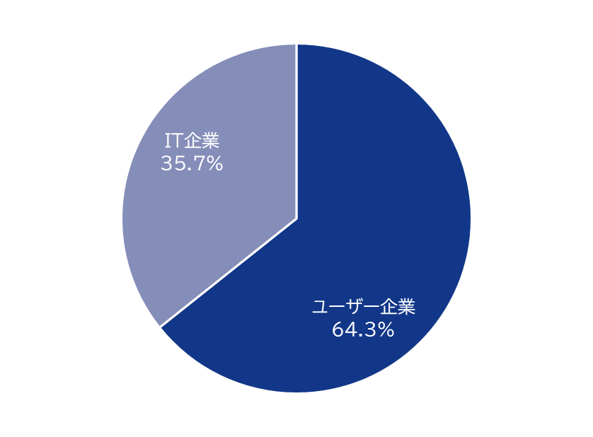
Majisemi's house list
Webinar
as a Service
Ability to attract attendees
Approximately 250,000
Own a house list!
Breakdown of user companies
House
List
Overall
*Estimated from seminar applicants from 2020 to 2024
©2018 MAJISEMI Inc.

Slide 14
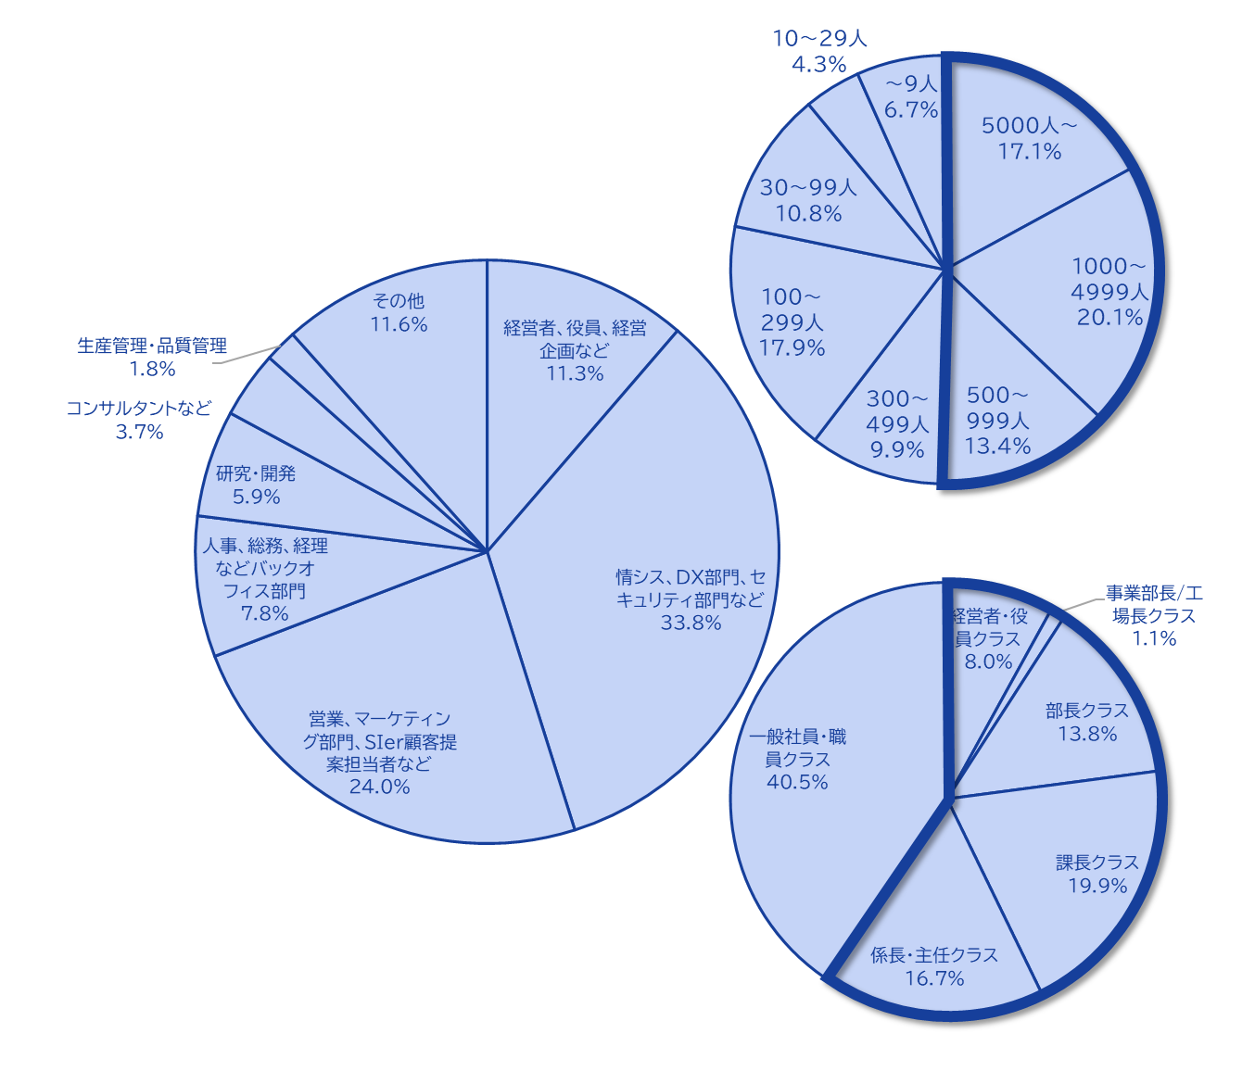
Majisemi's house list
Webinar
as a Service
The Majisemi list is
almost exclusively focused on the following attributes.
Nearly half work at
large companies
Company
Size
All industries × Information Systems Department, DX-related Department
All industries × Security Department
Manufacturing × Production/Manufacturing Department
All industries × Back Office Department
IT companies × All job functions
Job function
Breakdown of house list
At Majisemi, to ensure that participants in the webinar are a better match for your products and services, we do not use attribute specification (segmentation) when attracting participants via email, etc.
Instead, we design the webinar theme (title, announcement text)
on the Majisemi side,
adopting a method to increase the proportion of your target audience.
Emails are not sent to everyone but prioritized for those with a high interest in the set theme.
Position
Primarily managers
©2018 MAJISEMI Inc.

Slide 15





Why is it necessary to hold webinars?
Webinar
as a Service
The value of cold leads and the importance of repeating webinars
Lead acquisition
Nurturing & Business Negotiations
Contract
1 person
Hot leads
3 participants
Seminar hosting
30 participants
Cold lead
21 people
Repeatedly held
It's important to do so!
27 people
Including past participants, repeatedly holding webinars
to efficiently acquire new leads and nurture them.
If left unattended
21 people
80% sign contracts with
competitors within 2 years
Majisemi conducts long-term follow-ups with past participants,
and also offers 'MajiFollow Plus' to assist in appointment acquisition.
(SiriusDecision survey)
©2018 MAJISEMI Inc.

Slide 16








Reasons to use Majisemi
Webinar
as a Service
Outsource your webinar operations
Repeat PDCA to explore winning patterns
Planning
Audience acquisition
Seminar
Secretariat
Moderation
Appointment acquisition
(Optional)
Survey aggregation
Report creation
SEO article creation
Video production
(Optional)
Review &
Improvement
With a one-stop service,
from start to finish
Majisemi handles it all, so
All support included
with only audience acquisition costs!
Focus on the presentation
on the day!
©2018 MAJISEMI Inc.

Slide 17

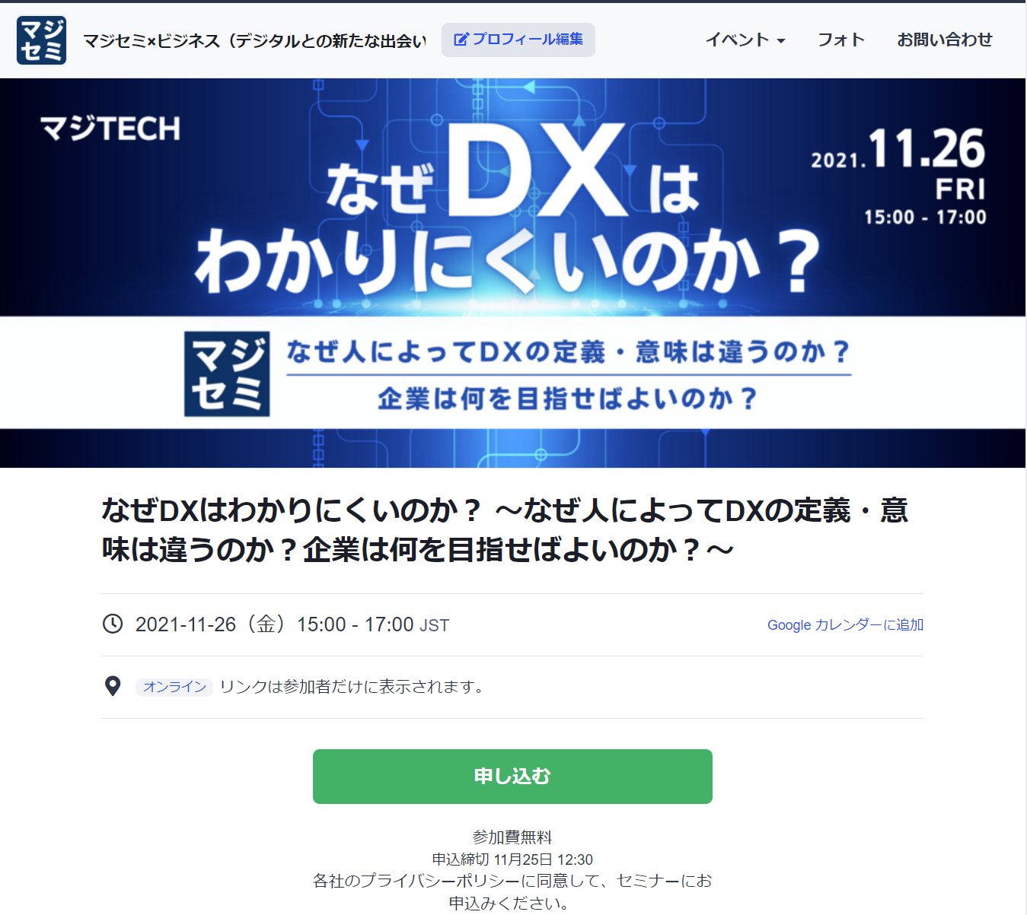
Reasons to use Majisemi
Webinar
as a Service
With one webinar, it is possible to acquire new leads and nurture existing leads simultaneously.
Audience page creation & publication
Audience acquisition
Majisemi management screen
Reminder distribution 1 week and 1 day before
Majisemi audience acquisition slot
Attracting customers with Majisemi
Majisemi slot
Applicant data
Distribution of participation URL
Plan finalized
To your company's customer acquisition slot
Applications are
not subject to charges, regardless of the number!
For nurturing your existing
house list,
reviving dormant customers,
and acquiring new leads through your website, etc.,
please make full use of this!
Your audience acquisition slot
After publication
We will provide
the URL
Attract customers through your company's house list and website, etc.
Your audience acquisition slot
Applicant data
On the mirror site of the Majisemi customer acquisition slot,
we will create a dedicated customer acquisition site URL for your company.
Delivery of all leads to your company
©2018 MAJISEMI Inc.
*Excludes disqualified applicants and those on the waiting list

Slide 18
Successful webinar case studies

Slide 19
(Case 1) "Changed the theme and achieved over 120 attendees" <Company C>
■ Customer challenges
・An SIer company mainly selling server/infrastructure services
・Hosting webinars in-house but unable to attract attendees
・Even when requesting media for customer acquisition, could not attract attendees
■ Plan utilized
・Visitor (later transitioned to Majisemi Club)
■ Majisemi's response
・Utilized know-how from hosting 1,000 webinars ann ually and tools like "trend analysis tools" to propos e and plan "attractive projects" on the Majisemi side
■ Results
・Achieved over 120 attendees
©2018 MAJISEMI Inc.

Slide 20
(Case 2) "Explored themes and achieved over 50% appointment acquisition" <Company T>
■ Customer challenges
・Tool vendor
・Focused on marketing through exhibitions, but struggled to convert to business negotiations
■ Plan utilized
・Visitor (later transitioned to Majisemi Club)
■ Majisemi's response
・While repeatedly holding webinars, explore "themes that can attra ct a certain level of audience and lead to business discussions."
■ Results
・Attracting around 30 attendees each time, improving the conversion rate from 10%→20%→50%
・The presenter personally conducts follow-ups after the webinar
©2018 MAJISEMI Inc.

Slide 21
(Case Study 3) "Switched to online and acquired 20% appointments" <Company Z>
■ Customer challenges
・A global IT company developing and selling packaged products and SaaS
・Struggling with attracting attendees and attendance rates at offline seminars
・Not leading to business discussions
■ Plan utilized
・Visitor
■ Majisemi's response
・Proposal for online (webinar)
・Implemented "seminar planning that leads to business discussions"
■ Results
・30 registrations→achieved 6 appointments
©2018 MAJISEMI Inc.
‹#›

Slide 22
(Case Study 4) "Acquired over 15% appointments with follow-up outsourcing" <Company I>
■ Customer challenges
・An infrastructure IT venture company also developing its own products
・Held several webinars with good attendance but not leading to business discussions
・The person in charge is busy and cannot conduct sufficient sales follow-up after webinars
■ Plan utilized
・Visitor
■ Majisemi's response
・Implemented "seminar planning that leads to business discussions"
・Implemented the follow-up outsourcing service "Majifolo" that makes calls immediately after the webinar ends
■ Results
・50 registrations→achieved 8 appointments
©2018 MAJISEMI Inc.

Slide 23
(Case Study 5) "AI presented and acquired 20% appointments" <Company A>
■ Customer challenges
・Foreign SaaS vendor
・Achieving attendance targets every time but not leading to business discussions
・Issues with presentation materials and content
■ Plan utilized
・Majisemi Club
■ Majisemi's response
・Implemented speech script creation by generative AI and presentation outsourcing by AI digital human
・Implemented the follow-up outsourcing service "Majifolo" that makes calls immediately after the webinar ends
■ Results
・20 registrations→achieved 4 appointments
©2018 MAJISEMI Inc.

Slide 24
About plans and pricing
©2018 MAJISEMI Inc.

Slide 25
Plan comparison
Pricing Plans
Recommended
 | Visitor | Majisemi Club Light | Majisemi Club Business Discussion Guarantee
Recommended for these individuals! | Planning to hold webinars 1 to 2 times a year | Planning to hold webinars 4 times or more annually Want to reduce cost per lead | Want business discussions (appointments) instead of just attracting attendees Want a guarantee
Cost per lead comparison | 14,500 yen | 12,000 yen (10 people monthly) 10,000 yen (for additional audience) | 20,000 yen (30 people over 3 months) 13,500 yen (for additional audience)
Not subject to duplicate charges for past applicants *See each plan description for details | None | Available | Available
Meeting (appointment) guarantee *See each plan description for details | None | None | Available
Contract period | Per session | Monthly (Automatically renewed) | Every 3 months (Automatically renewed)
©2018 MAJISEMI Inc.

Slide 26
Are there any services other than the basic plan that interest you?
Service Map
Limited slots
First-come, first-served
Exhibition
Joint exhibition
Your company's owned leads
(Not subject to charges)
Webinar hosting
Lead follow-up, proposal, and order
Recommended
New service
Presentation manuscript and materials
Creation support
AI-based presentation support
Webinar hosting
(Visitor or Majisemi Club)
Follow-up immediatel y after the webinar
(Maji Follow)
Sales outsourcing
(Proposal and order)
(Maji Sales)
Your company's inside sales
Or fiel d sales
Recommended
New service
Many companies
are utilizing
Missed
Broadcast
Rebroadcast
2-step
Webinar
Many companies
are utilizing
Utilization of webinar content
Many companies
are utilizing
Many companies
are utilizing
Recommended
New service
SEO article
Creation
Full video
Provided/Free
Full video
Provision/secondary use
Summary
Video production
SEO video creation
©2018 MAJISEMI Inc.

Slide 27
Majisemi Club or Visitor?

Slide 28

Plan comparison
Pricing Plans
Visitor
Seminar hosting 30 people attracted
Majisemi Club
Seminar hosting 30 people attracted
(Monthly fee)
10 additional people every month
10 people × @12,000 yen
Attraction slots
10 people
Use the 20 people free benefit
Attraction slots
20 people
Billing
30 people × 14,500 yen = 435,000 yen (excluding tax)
Billing
10 people × 12,000 yen = 120,000 yen (excluding tax)

Slide 29
Majisemi Club Initial 20 People Free Benefit
Campaign
By contracting Majisemi Club, you can use this benefit at the first event.
You can cancel anytime. Even if you cancel after one time, it's more advantageous than being a visitor.
Image of hosting using special offers
 | January | February | March | April
Membership fee billing amount | 120,000 yen | 120,000 yen | 120,000 yen | 120,000 yen
Additional attraction slots | +10 people | +10 people | +10 people | +10 people
By campaign Additional attraction slots (free) | +20 people | - | - | -
Remaining attraction slots | 30 participants | 10 people | 20 people | 30 participants
Seminar hosting | 30 participants | - | - | 30 participants
You can purchase additional audience slots anytime
(at a cost-effective 10,000 yen each) to
host additional webinars
First 20 participants free
Immediately host a webinar for up to 30 participants
Webinar hosting available
If hosting only once initially and canceling at the end of March (notification by the end of February),
Only the membership fee of 120,000 yen × 3 months will be charged.
©2018 MAJISEMI Inc.

Slide 30
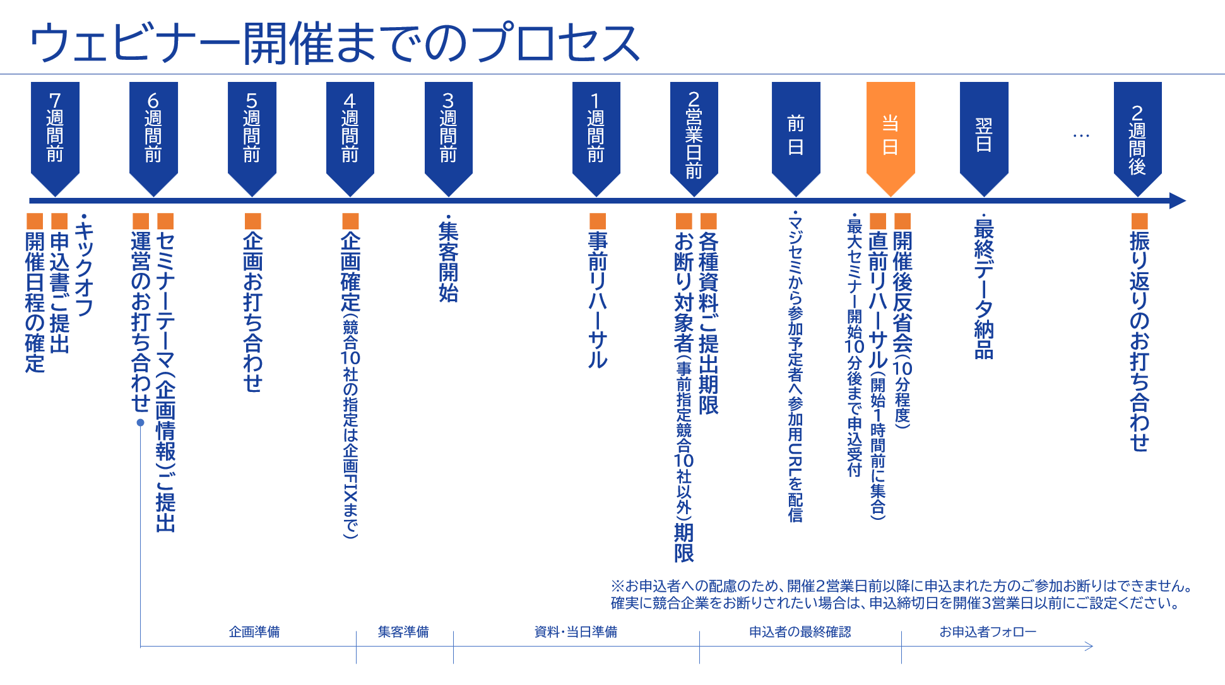
©2018 MAJISEMI Inc.

Slide 31
Take this opportunity to start with Majisemi!
Clients using Majisemi have shared
The audience was good,
and it led to business negotiations
Awareness increased, and inquiries from the web
also increased
The staff (attendants and cast) were excellent,
making seminar hosting 'easy'
such feedback.
And most client companies repeatedly host seminars with Majisemi.
However, you may have the following concerns.
"Will the target companies really attend?"
"How much easier will the operation become?"
For such customers,
we offer the "Majisemi Club Membership First 20 Participants Free" campaign.
Please try Majisemi!
©2018 MAJISEMI Inc.

Slide 32
~Please check later~
(For your reference) Other information

Slide 33


Reasons to use Majisemi
Webinar
as a Service
Outsource your webinar operations
A dedicated planning manager will create the title and announcement text!
Planning
A Majisemi planning specialist with IT knowledge will collaborate with you to create a webinar plan that achieves audience acquisition and business negotiations.
STEP1
STEP2
STEP3
Formal Application
Please enter product name, product information, target, and pain points into the management system.
Planning meeting
We will hold a one-hour meeting online.
We will align details based on preliminary information.
Plan finalized
Please press the approval button in the management system to finalize the plan.
At our company
Preparation for publishing the
attraction page has
started!!
By email
Confirmation
Attendants (seminar secretariat) will support you until the webinar is hosted!
Attendant
(Seminar Secretariat)
Attendants with experience in managing 1,000 seminars annually will accompany you until the seminar is hosted.
Feel free to consult us about any issues!
STEP4
STEP 5
STEP6
On the day
・Moderation
・Collecting surveys
Publishing the attraction page
Creating the application page
Handling applicants
・Responding to inquiri es ・Sending reminders
・Issuing participation URLs
Rehearsal
・Confirming the flow and requests for the day ・Checking the speaker's connection e nvironment ・Confirming preparation status
Report creation
Cast
Cast
©2018 MAJISEMI Inc.

Slide 34
Reasons to use Majisemi
Webinar
as a Service
Dedicated support from the planning stage
Flow of the planning stage
Preliminary preparation
The planning manager will gather information on the seminar theme you share in advance and create a proposal for promotional angles.
Planning meeting
We will hold a meeting for about one hour. We will propose promotional angles and align details.
Creation of the proposal
Based on the details aligned in the meeting, the planning manager will create a draft of the title and announcement text.
Submission of the proposal
After creating the proposal, the planning manager will submit it via email.
Confirmation of the proposal content
Please review the proposal content and share any feedback you may have.
Finalization of the plan
Once the content review and feedback revisions are complete, please press the approval button in the management system to finalize the plan.
Preparation for publishing the
Start of preparation for publishing
©2018 MAJISEMI Inc.

Slide 35
Event flow
On the day of the event
Webinar
as a Service
Event time
Distribution tools
Typical seminar flow
You can choose from 5 slots
(Weekdays only ※No sessions on weekends or holidays)
1 hour per seminar is the standard
Choose from 2 options
*We recommend Zoom for its features and streaming quality
*For seminars hosted by Majisemi, an additional fee applies for events longer than 1 hour (150,000 yen/hour)
10:00～11:00
Registration begins
15 minutes
11:00～12:00
Opening
(Majisemi Cast)
Zoom
Teams
13:00～14:00
5 minutes
Presentation
14:00～15:00
30-40 minutes
Poll
15:00-16:00
Q&A
(Navigated by Majisemi Cast)
*On Mondays, only the 14:00 and 15:00 sessions are available
*Majifolo is only conducted at the 10:00 and 11:00 sessions
*For seminars targeting the manufacturing industry, to avoid theme overlap, sessions are held at 11:00 and 13:00
10-15 minutes
End
©2018 MAJISEMI Inc.

Slide 36
Reasons to use Majisemi
Webinar
as a Service
Effective use of content
Branding & New Lead Acquisition
Create articles from presentation content
Register on your own site, also for SEO measures
SEO article
Create (blog)
During webinar hosting
Reuse content to
Continue lead nurturin g and acquire new lea ds even after hosting
Distributed later exclusively to absentees
Rebroadcast past Majisemi event videos
Effortless event with no live presentation
Webinar Hosting
Missed broadcast
Rebroadcast
Recorded video
Upload to your website or YouTube
Summary vid eo creation
On your website or
Post on your company-managed social media
Webinars or videos not hosted by Majisemi
Secondary use on portals and advertising media
Full vide o provided/free*
Full video p rovided/secondary use*
Lead nurturing
Listed on majisemi.com
Acquire new leads
Majisemi Club Benefits
※In the trial, we do not provide full videos regardless of free or paid. However , after the main contract, past sessions can be provided regardless of the plan.
Majilead
Material download
©2018 MAJISEMI Inc.

Slide 37
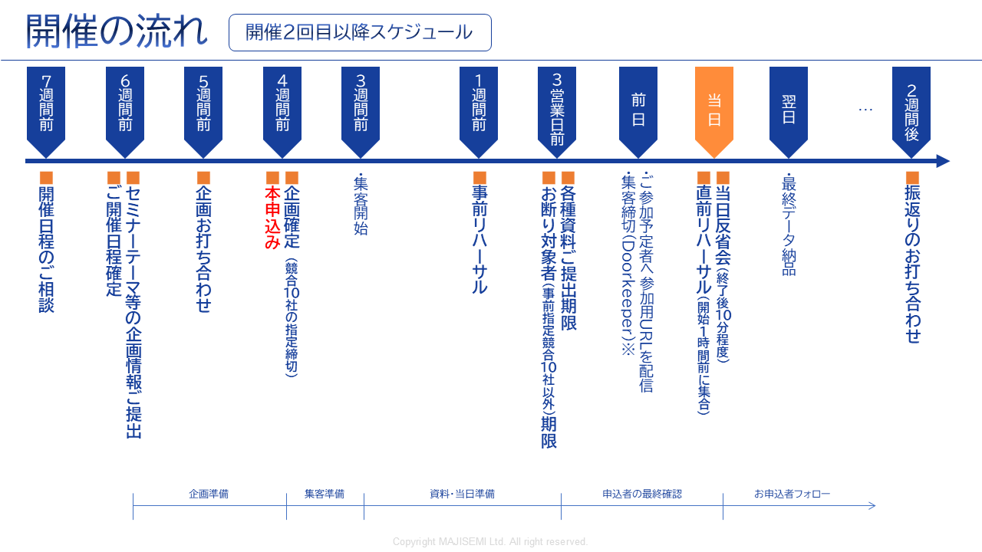
Webinar
as a Service
※To consider applicants, we cannot accept cancellations for those who applied within 2 business days before the event.
If you want to ensure competitors are excluded, please set the application deadline 3 business days prior.
©2018-2024 MAJISEMI Inc.
©2018 MAJISEMI Inc.

Slide 38
Basic Plan
Majisemi Visitor
Plan Details
Reference Plan
Pricing Plans
This is a completely performance-based plan for hosting a one-time webinar.
You can choose from four types depending on how much you want to delegate.
We accept applications from 20 people.
If there are only 10 applications, billing will be for 10 people only.
14,500 yen per application (excluding tax)
・ Host and apply each time
・ Performance-based billing according to the number of attendees
・ Applications from 20 or more people
(Billing is only for the number of attendees)
※To accurately track the number of attendees, we will prepare the application page and provide the list to your company.
※Actual billing will be based on the number of applicants up to the maximum number above. If capacity is reached, application acceptance will stop.
※For privacy protection, the list will be delivered directly to the seminar organizer.
※Billing includes not only participants but also absentees (pre-cancellations, on-the-day cancellations).
※We will strive to attract as close to the maximum as possible, but attendance is not guaranteed.
※There may be cases where no attendees are attracted due to the seminar theme or other concurrent events.
Management
Management
Menu |  | Planning | Audience acquisition LP Installation | Moderator | Other Media Import | URL Delivery Reminder | Zoom Provision | Post-event Survey
Majisemi Visitor | Standard | ○ | ○ | ○ | No Other Media Posting | ○ | ○ | ○
 | Planning & Customer Acquisition | ○ | ○ | - |  | - | - | -
 | Customer Acquisition & Management | - | ○ | ○ | - | ○ | ○ | ○
 | Customer Acquisition Only | - | ○ | - | - | - | - | -
Product Name | Content | Quantity | Unit Price (¥) | Amount (¥)
Majisemi Visitor (20 people) | Webinar Planning, attracting attendees, and operation | 20 | 14,500 | 290,000
Visitor Plan Reference Plan for 20 People |  | Subtotal |  | 290,000
 |  | Consumption Tax (10%) |  | 29,000
 |  | Total (Including Tax) |  | 319,000
©2018 MAJISEMI Inc.

Slide 39
Basic Plan
Majisemi Club Light
Plan Details
Reference Plan
Pricing Plans
Monthly Fee 120,000 yen (excluding tax) *Includes 10 customer acquisition slots for the Light Plan
Additional Customer Acquisition Slot @10,000 yen (excluding tax)
Automatic renewal every month
Add 10 customer acquisition slots every month
The minimum capacity for webinars is 30 people
If hosting a webinar with 30 participants in the first month, purchase an additional 20 participant slots (@10,000 yen each)
If the number of participants does not reach the target, the remaining slots can be carried over to the following months
Additional participant slots can be purchased for @10,000 yen
If someone who has registered for your company's past three seminars (subject to charges) registers again for the current seminar, they will not be charged for the current seminar (fan development)
Other benefits include providing leads from those who download publicly available presentation materials, offering a branding dashboard, and providing trend analysis tools
Majisemi Club is a membership service that conducts repeated webinars to improve them through the PDCA cycle. Admission is subject to screening.
For Majisemi Club, we provide a one-stop service of planning, customer acquisition, moderation, and management. We cannot support only customer acquisition, etc.
Also, the seminar content (planning) will be a "problem-solving seminar" rather than a "product introduction." Product introductions will be conducted in the latter half of the presentation. The seminar content will be decided in consultation with the Majisemi planning members. It may not be possible to hold it on the theme your company desires. If you wish to decide the theme yourself, please use the Visitor Plan.
Please note that, considering the purpose of the aforementioned Majisemi Club, a penalty will be set for cancellations within one year of the contract start. (We will charge the difference from the Visitor Plan fee.)
※To accurately track the number of attendees, we will prepare the application page and provide the list to your company.
※ If the capacity is reached, we will stop accepting applications.
※For privacy protection, the list will be delivered directly to the seminar organizer.
※ Not only participants but also absentees (cancellations before and on the day) are counted in the number of attendees.
※ The contract is automatically renewed monthly, and this will continue thereafter.
※ Upon withdrawal, refunds for unused customer acquisition slots cannot be made. Also, you cannot rejoin Majisemi Club for one year after withdrawal.
※ To withdraw, please contact us by email by the end of the month prior to the withdrawal month.
※ Benefits are subject to change.
For those who have challenges in converting seminars into business discussions or want to strengthen their website content and SEO, please consider our value set plans mentioned later.
Product Name | Content | Category | Amount (¥)
Majisemi Club Light (30 participants) | Planning, attracting participants, and managing webinars | Monthly fee | 120,000
Majisemi Club Light Plan Attracting 30 participants, If 10 participants are attracted through the monthly fee and 20 through additional slots |  | Additional participant slots | 200,000
 |  | Consumption Tax (10%) | 32,000
 |  | Total (Including Tax) | 352,000
©2018 MAJISEMI Inc.

Slide 40
Basic Plan
Majisemi Club Light
billing pattern
Pricing Plans
Example of webinar hosting and billing with Majisemi Club
add 10 attendees every month
Webinar
Held
Webinar
Held
Webinar
Held
seminars can be held anytime (or not at all)
(target capacity is 30 or more, rebroadcasts are 10 or more)
Webinar
Held
 | January | February | March | April | May | June | July | August | September | October | November
Additional attraction slots | +10 | +10 | +10 | +10 | +10 | +10 | +10 | +10 | +10 | +10 | +10
Beginning of the month Remaining attraction slots | 10 | 10 | 20 | 30 | 15 | 10 | 20 | 30 | 40 | 50 | 10
Monthly fee billing | 120,000 yen | 120,000 yen | 120,000 yen | 120,000 yen | 120,000 yen | 120,000 yen | 120,000 yen | 120,000 yen | 120,000 yen | 120,000 yen | 120,000 yen
Seminar hosting Target capacity | 30 participants |  |  | 30 participants | 50 participants |  |  |  |  | 50 participants
Seminar hosting Participant achievement | 30 participants |  |  | 25 participants | 48 participants |  |  |  |  | 50 participants
consumption of attendee slots | -10 |  |  | -25 | -15 |  |  |  |  | -50
end of month Remaining attraction slots | 0 | 10 | 20 | 5 | 0 | 10 | 20 | 30 | 40 | 0 | 10
Additional participant slots | 20 |  |  |  | 33
Additional participant slots billing | 200,000 yen |  |  |  | 330,000 yen
target capacity is 30 or more
holding events with 50, 100 participants, etc. is OK
seminar with 30 participants from the first month is OK
carry over any shortfall to the next month
any shortfall will be billed at 10,000 yen per person
there will be no more attendees than the target capacity
©2018 MAJISEMI Inc.

Slide 41

Basic Plan
Majisemi Club Business Discussion Guarantee
Plan Details
Reference Plan
Pricing Plans
600,000 yen every 3 months (excluding tax)
Contract is automatically renewed every 3 months
Guarantee of 30 attendees and 3 business meetings every 3 months
Majifolo is provided for free
If the target is not met, the shortfall will be carried over to future seminars
For additional events with more than 31 participants, 13,500 yen per registration
If someone who has registered for your company's past three seminars (subject to charges) registers again for the current seminar, they will not be charged for the current seminar (fan development)
Other benefits include providing leads from those who download publicly available presentation materials, offering a branding dashboard, and providing trend analysis tools
This is a plan that automatically renews every 3 months. We guarantee 30 attendees and 3 business meetings (appointments).
We handle everything from planning the seminar content, attracting attendees, managing the event on the day, to sending materials to participants.
Majifolo is included in the fee.
If the initial seminar does not meet 30 people and 3 cases, it will be carried over to that quarter or the next quarter,
We will hold additional seminars. (The basic aim is to achieve the target in the initial attempt)
*To accurately track the number of attendees, we will prepare the registration page and provide the list to your company.
*If the capacity is reached, we will stop accepting applications.
※For privacy protection, the list will be delivered directly to the seminar organizer.
※ Not only participants but also absentees (cancellations before and on the day) are counted in the number of attendees.
*The contract is automatically renewed every 3 months and will continue in the same manner.
※ Upon withdrawal, refunds for unused customer acquisition slots cannot be made. Also, you cannot rejoin Majisemi Club for one year after withdrawal.
*To withdraw, please notify us by email by the end of the month prior to the withdrawal month.
*We may not be able to accommodate requests with a business negotiation guarantee.
※ Benefits are subject to change.
Product Name | Content | Quantity | Unit Price (¥) | Amount (¥)
Majisemi Club event (30 participants) | Planning, attracting participants, and managing webinars | 1 | 600,000 | 600,000
Majifolo (30 participants) | Appointment setting via phone and email for participants | 30 | 3,500 | 105,000
 | All cases are free under the Majisemi Club business negotiation guarantee | 30 | -3,500 | -105,000
Majisemi Club Business Negotiation Guarantee Plan Reference plan for 30 participants |  | Subtotal |  | 600,000
 |  | Consumption Tax (10%) |  | 60,000
 |  | Total (Including Tax) |  | 660,000
Guaranteed attendee acquisition and business meetings!
©2018-2023 MAJISEMI Inc.

Slide 42
Cost-effective Plans for Majisemi Club (Planned Revision)
Pricing Plans
Recommended
 |  | Light | Silver | Gold | Platinum | Premium
Included Services | Webinar hosting | ● | ● | ● | ● | ●
 | SEO article creation | ― | ●※1 | ― | ― | ●※1
 | Majifolo | ― | ― | ●※2 | ●※2 | ●※2
 | Majifolo Plus | ― | ― | ― | ●※3 | ●※3
 | Summary Video | ― | ― | ― | ― | ●※1
Additional Audience Slot Gift (Special Offer)※4 |  | ― | Every Year for 10 People Equivalent to 100,000 yen | Every Year for 20 People Equivalent to 200,000 yen | Every Year for 40 People Equivalent to 400,000 yen | Every Year for 80 People Equivalent to 800,000 yen
Monthly fee |  | 120,000 yen | 135,000 yen | 155,000 yen | 255,000 yen | 385,000 yen
Simply a Webinar
Only Want to Request Hosting
Want to Utilize Presentation Content
On the Website
Want to Follow Up Immediately
After the Webinar
Want to Ensure Conversion
From Webinar to Business Negotiation
Want to Maximize
Webinar Effectiveness
※1 SEO article creation and summary video creation can be conducted up to 4 times a year. Additional options can be purchased for more.
※2 Majifolo can be conducted for up to 120 people a year. Additional options can be purchased for more.
※3 Includes monthly activity costs for Majifolo Plus. A success fee of 30,000 yen per appointment is charged separately.
※4 The additional audience slot gift is granted one year after joining the Majisemi Club and every year thereafter in the same month.
(All amounts are tax-exclusive)
©2018 MAJISEMI Inc.

Slide 43
Other options *Please consult with us for details
Webinar
as a Service
Name | Price (excluding tax) | Content
Majifolo (Post-seminar follow-up) | @3,500 yen × number of attendees | Majisemi's dedicated follow-up staff will contact participants and absentees via email and phone immediately after the seminar ends.
SEO article creation | 50,000 yen | We will create an article of approximately 3,000 characters with SEO in mind based on the seminar content. By publishing it on your website, you can promote content marketing.
Full video provision/paid | 200,000 yen | This is an option to provide seminar videos for secondary use. *We offer it free of charge within certain usage limits. During the trial, neither paid nor free provision is available.
Summary video creation | 50,000 yen | When posting seminar videos on YouTube, etc., long videos tend to be disliked. Therefore, we will edit and provide a 5 to 10-minute video.
Missed broadcast | 50,000 yen | For those who registered for the seminar but were absent on the day, we will allow them to view the day's video.
Rebroadcast | @14,500 yen/10,000 yen | Using recordings from past Majisemi events, we will hold additional webinars without hassle.
Two-step webinar | 200,000 yen | We will plan and hold a theme that leads to more business discussions (appointments) for those who have previously registered for your webinars (your prospective customers), such as competitor comparisons, product introductions, demos, etc.
Operational support (operation outsourcing) | 200,000 yen | We will manage your seminar operations. This includes creating the registration page, managing registrants, lending Zoom, and moderating on the day. (Attracting attendees is not included. You will need to handle that.)
Presentation by Majisemi representative Terada Presentation at your seminar | 300,000 yen～ *Approximately 30 minutes to 1 hour | Majisemi representative Terada will facilitate presentations, discussions, or panel discussions at your seminar. Please consult us about the theme.
Keynote speech by 'Evangelist AI' Digital Terada | 100,000 yen | 'Evangelist AI' Digital Terada, utilizing generative AI, will deliver a keynote speech at your webinar. - Want to give a seminar presentation but lack time to create the script and slides - No skilled presenters among employees (or they are too busy), so want to outsource the presentation as well
SEO video creation | 50,000 yen per video～ *In units of 10, excluding initial costs | This is a strategy to aim for top rankings in YouTube and Google video searches. Majisemi will create a dedicated AI avatar for your company and produce video content explaining terms. Scripts can also be delivered, and blog utilization is possible.
Product comparison video creation | 500,000 yen～ *Excluding initial costs | We will create a competitive product comparison video to strongly recognize the strengths of your product. Majisemi will create a dedicated AI avatar for your company and produce product comparison video content. It can also be distributed in webinars.
©2018 MAJISEMI Inc.

Slide 44
Notes
Webinar
as a Service
■ Generally, meetings start 6 weeks in advance, and the formal application is made 4 weeks before the event.
Additional charges
Cancellation fee
For all services, if you cancel after making a 'formal application' through Majikan (Majisemi management screen) or after receiving the order form/application form, a 100% cancellation fee will be charged.
However, for webinar events, the cancellation fee is capped at the equivalent of 20 visitors for general visitors and 30 slots for Majisemi Club members.
For Majifolo, the cancellation fee is capped at the equivalent of 20 visitors for general visitors and 30 slots for Majisemi Club members.
If adjustments to the title, announcement text, etc., are delayed and the webinar cannot be published by 5 PM, 10 business days before the event date, it will be treated as a cancellation and the above cancellation fee will be charged.
No refunds will be made for remaining slots upon withdrawal from Majisemi Club.
Considering the purpose of Majisemi Club, a penalty is set for cancellations within one year of the contract start. Please understand. (The difference from the visitor fee will be charged.)
Majisemi Visitor
Orders placed less than 4 weeks before the event will incur a surcharge.
 | Unit price (excluding tax) | Upper limit specification
Basic fee (Order placed more than 4 weeks before the event) | 14,500 yen | 20 or more people
Order placed less than 4 weeks before the event | ×1.25 times surcharge
Order placed less than 3 weeks before the event | ×2 times surcharge
Various Majisemi Club
If the formal application cannot be made 4 weeks before the event, there is no surcharge, but the event will be postponed upon consultation.
©2018 MAJISEMI Inc.

Slide 45
Majisemi Inc.

Slide 46

Company name
Headquarters location
Representative name
Business description
Seminar hosting achievements
Established
Capital
Number of employees
Majisemi Inc.
3rd Floor, Shiodome Building, 1-2-20 Kaiga n, Minato-ku, Tokyo 105-0022 Yuichi Terada
Operation of the IT and manufacturing industry specialized seminar marketing service 'Majisemi'
Last year's achievements: Approximately 1,000 events held, total attendance of about 60,000 people (2023)
January 2018
10 million yen
45 employees
About Us
Company Overview
Creating new encounters and experiences with digital-rel ated products and services to promote the development of domestic industries and the advancement of engineers.
To achieve this, we convey the excellence and potential of technology widely to society, regardless of the size of the providing company.
We clearly communicate to end users not the technology itself, but how it can solve their problems.
By 2025, we aim to host 2,000 webinars annually.
MISSION
セミナーをエンタメに変える
セミナーで社会を変える
おかげ様で３つのNo.１
獲得しました！1
集客に強いセミナーNo.1
IT責任者が
選ぶセミナー
No.1
新規の商談獲得に
強いセミナー
No.1
©2018 MAJISEMI Inc.
日本マーケティングリサーチ機構調べ調査概要:2021年サービスの比較印象調査

Slide 47
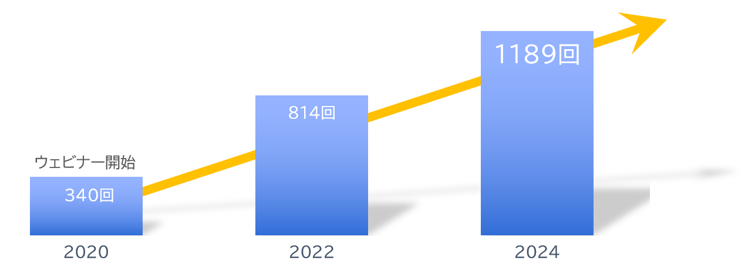
About Us
With clients
Number of seminars held
Increasing every year!
A10ネットワークス株式会社
アイテック阪急阪神株式会社
アドバンテック株式会社
株式会社アクシオ
株式会社アシスト
伊藤忠テクノソリューションズ株式会社
株式会社インターネットイニシアティブ
インフォコム株式会社
エクイニクス・ジャパン株式会社
SCSK株式会社
エフセキュア株式会社
エムオーテックス株式会社
エンカレッジ・テクノロジ株式会社
エントラストジャパン株式会社
株式会社オージス総研
株式会社オプロ
クリックテック・ジャパン株式会社
クロス・ヘッド株式会社
KCCSモバイルエンジニアリング株式会社
株式会社サーバーワークス
サイオステクノロジー株式会社
サイバートラスト株式会社
株式会社ジール
CTCシステムマネジメント株式会社
株式会社システナ
シンガポールテレコム・ジャパン株式会社
GMOグローバルサイン株式会社
JBサービス株式会社
スターティアレイズ株式会社
Smart Style Co., Ltd.
Sumitomo Electric Information Systems Co., Ltd.
Zoho Japan Corporation
Soliton Systems K.K.
Dynatrace
TIS Inc.
Techvan Co., Ltd.
TechMatrix Corporation
Delivery Consulting Inc.
Dell EMC
NSW Inc.
Hulinks Inc.
Netskope Japan Co., Ltd.
Pasona Tech, Inc.
Nippon Telegraph and Telephone East Corporation
Fujitsu Limited
Fujitsu Communication Services Limited
Fuji Electric IT Solutions Co., Ltd.
Mitsubishi Electric Information Systems Corporation
Mirantis Japan K.K.
Monstar Lab, Inc.
Red Team Technologies Inc.
Rosetta Corporation
(Agency)
MM Research Institute, Ltd.
Creative Bank Inc.
Target Media Co., Ltd.
Nikkei Advertising Inc.
Bigbeat Inc.
Mynavi Corporation
取引実績
Major clients only, in alphabetical order
©2018 MAJISEMI Inc.

Slide 48
集客に強いセミナーNo.1
No.1 seminar for acquiring new business negotiations
No.1 seminar chosen by IT managers
Survey by Japan Marketing Research Organization Overview: 2021 Service Comparison Impression Survey
セミナーをエンタメに変える
セミナーで社会を変える

